Slide 1
Summer Term 23 Responsible Artificial Intelligence Lecture-2: Towards Responsible AI - Principles and Criteria for AI Alignment
Prof. Dr. Holger Giese (holger.giese@hpi.uni-potsdam.de)
Christian Medeiros Adriano (christian.adriano@hpi.de) - “Chris”
Christian Zöllner (Christian.zoellner@hpi.de)
Matthias Barkowsky (matthias.barkowsky@hpi.de)

Slide 2
Project Example: Engineering support of Design, Verification & Validation of Ethical Argumentation
Outcome: Methodology, Models, Data, and Tool Prototype
Topic: Perception of Competing Arguments for Ethical Dilemmas on <Safety x Trustworthiness x Privacy x Fairness>
Possible Project Tasks:
Describe the specific ethical dilemma with examples (domain-specific or multiple-domains)
Describe the arguments that cover the various aspects of the dilemma (use multiple definitions/understandings of an ethical principle)
Codify arguments using some model from a methodology or tool
Use the model to generate a critique on the dilemma, e.g., identify fallacies, false assumptions, mis-understandings, etc.
Design an experiment to evaluate the human subjective perception of these arguments (use threats to validity to check your assumptions)
Revise the design after executing a proof of concept
Develop a prototype that demonstrates the ethical issues and how they are mitigated

Slide 3
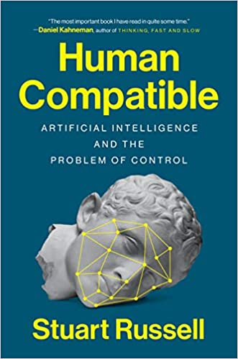
Example of Typical AI Safety Fallacy
Fallacy examples: “Unsafe AI can be prevented by (1) specifying unharmful goals (2) by disabling it in case of potential harm.”
However:
“You can’t fetch the coffee if you are dead!” – Stuart Russell (Human Compatible book [1])
[1] https://en.wikipedia.org/wiki/Human_Compatible

Slide 4
Project Example: Engineering support of Design, Verification & Validation of Ethical Argumentation
Discussion of Findings:
Which fallacies or false assumptions were successfully identified? Which were not?
Which counterarguments for these fallacies are well perceived? By which actors?
Are there external factors (demographics, institutions) correlated with the findings?
Is there any detectable confounding? Or plausibly hidden?
Implications to Engineering:
What variations in the argumentations could be credited/blamed for a more positive/negative perception of the technology/feature?
Are there possible improvements in the how we express the arguments? For instance, to prevent encoding hidden fallacies?
Are there plausible ways to intervene in the argumentation to improve its positive perception or to increase the chances of identifying a fallacy?
Is there any pre-validation/verification of the model that could have been done to improve the results?

Slide 5

Sources (Online)
MIT Course on Fairness
MIT RES.EC-001 Exploring Fairness in Machine Learning, Spring 2020
https://ocw.mit.edu/RES-EC-001S20
USAID – United States Agency for International Development
Artificial Intelligence and Machine Learning
https://www.usaid.gov/digital-development/artificial-intelligence
Reflecting the Past, Shaping the Future: Making AI Work for International Development
https://www.usaid.gov/sites/default/files/documents/15396/AI_ExecutiveSummary-Digital.pdf
Discussion Group on Human-Centered AI (HCAI)
https://groups.google.com/g/human-centered-ai

Slide 6
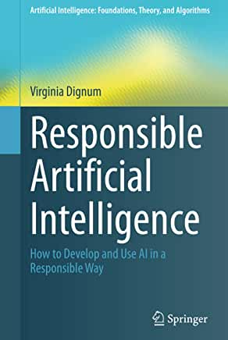
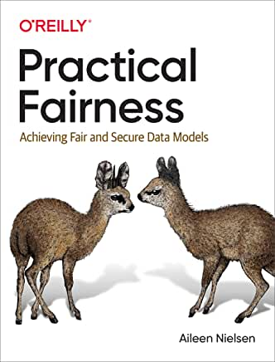
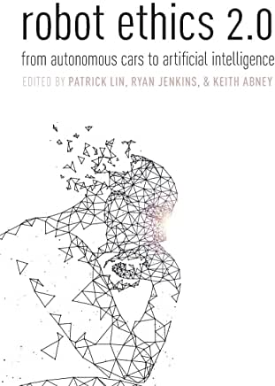

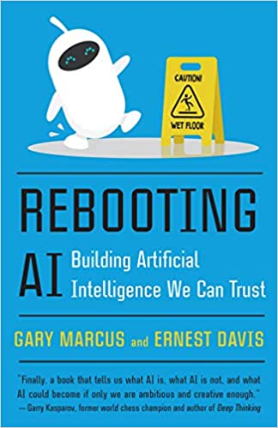

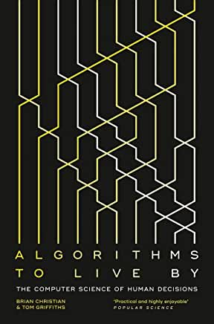
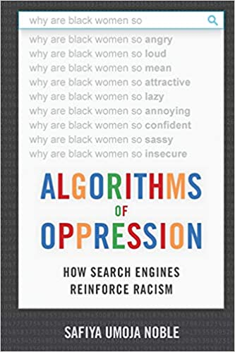
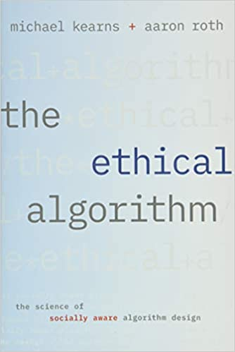
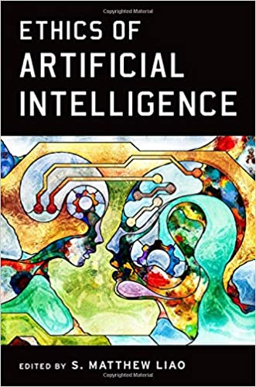
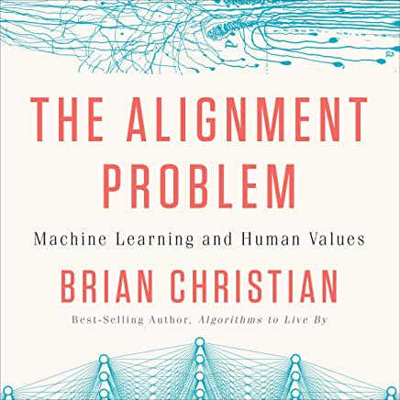
Sources (Books that we have been reading)
Architects of Intelligence: The truth about AI from the people building it
Armed Drones and the Ethics of War: Military Virtue in a Post-Heroic Age

Slide 7
How Good Models Can go Wrong [USAID 2020]
Hard-Coded Inequities: when real-world biases are present in training data, the resulting model will include the same biases.
Opaque Models: technical choices that favor prediction power can reduce model interpretability
Misplaced Trust: overconfidence on models might lead to confirmation bias (only trust when the model agrees with one’s beliefs)
Wrong tool for the Job: Models might not be aligned with decision-making needs.
Active Misuse: violations of privacy, spread of fake news, promotion of hate speech, prejudice messages
Can you think of concrete ethical dilemmas that entail trade-offs between these concerns versus the engineering principles of maximizing?
efficiency (cost, reusability)
efficacy (availability, speed)
robustness (generalizability, portability)
quality (accuracy)
Notes:
[USAID 2020] Reflecting the Past, Shaping the Future: Making AI Work for International Development
https://www.usaid.gov/sites/default/files/documents/15396/AI_ExecutiveSummary-Digital.pdf

Slide 8
Design Principles [USAID 2020][Gandhi 2020] Relevance, Representativeness, Value, Explainability
Relevance - is it solving the correct problem?
Representativeness - is the data free of relevant bias?
Value – the new technology costs and risk justify its benefits
Predictions are more accurate, and variances better explained than alternative methods?
Are predictions "actionable" (causal/counterfactual models)?
Are predictions hey timely and do they reach the right person?
Explainability - How well* the process of building models and generating predictions communicated?
*well = transparent, tailored, understandable to guarantee trustworthiness
Notes:
[USAID 2020] Reflecting the Past, Shaping the Future: Making AI Work for International Development
https://www.usaid.gov/sites/default/files/documents/15396/AI_ExecutiveSummary-Digital.pdf
Critical aspects of explainability = selection of data, models, and possible unexpected uses, etc.

Slide 9
Design Principles [USAID 2020][Gandhi 2020] Auditability
How well one can query and monitor the decision process that relies on the model?
Goals: ensure that decisions are fair (justice), unbiased (correct), and do not harm users (safety/secure/privacy compliant)
Challenges: models are often harder to understand
Auditability may require specialized technical and legal infrastructure, because of complexity or restricted access to proprietary information.
Notes:
[USAID 2020] Reflecting the Past, Shaping the Future: Making AI Work for International Development
https://www.usaid.gov/sites/default/files/documents/15396/AI_ExecutiveSummary-Digital.pdf

Slide 10
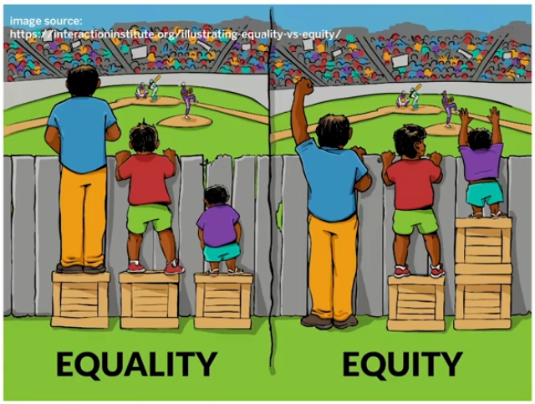
Principles [USAID 2020][Gandhi 2020] Equity
How well the model prevents disproportionate benefit or harm to certain individuals or groups.
Does the model produce worse predictions for certain groups, e.g., face recognition failing depending on skin color?
How to measure it? Unexplained differences in the rates of false positives or false negatives.
Notes:
[USAID 2020] Reflecting the Past, Shaping the Future: Making AI Work for International Development
https://www.usaid.gov/sites/default/files/documents/15396/AI_ExecutiveSummary-Digital.pdf

Slide 11
Fairness Criteria [USAID 2020][Gandhi 2020] Accountability/Responsibility
How well one can attribute credit or blame for decisions made by the model?
Challenge: many areas do not yet have a legal framework, for instance, like medical diagnosis and aviation have.
However, does a risk of not taking a decision because of legal support out-weights the consequences of inaction?
Notes:
[USAID 2020] Reflecting the Past, Shaping the Future: Making AI Work for International Development
https://www.usaid.gov/sites/default/files/documents/15396/AI_ExecutiveSummary-Digital.pdf

Slide 12
Protected Attributes by Law (in some countries)
age
race
skin color
eye color
height
weight
medical condition
religion
cultural heritage
nationality
citizenship
SOGIE - sexual orientation, gender identity & expression
marital status
family size (has children or not)
educational background
income
socioeconomic background
etc.
Can you think of concrete ethical dilemmas that entail trade-offs between access to these attributes in order to engineer effective AI-systems?

Slide 13
Confusion Matrix
Prediction
Negative
Positive
True Negatives
False Positives
Negative
Actual
True Positives
False Negatives
Positive

Slide 14
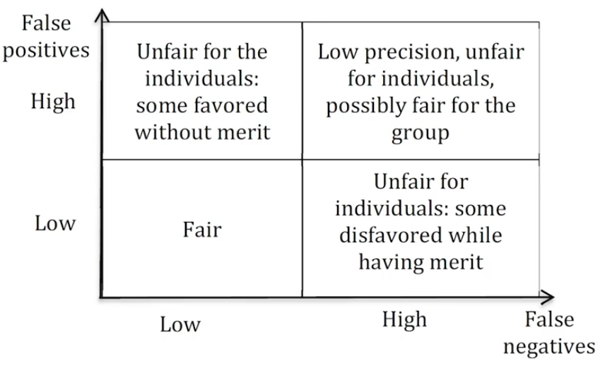
Fairness at the Individual Level vs Group Level

Slide 15
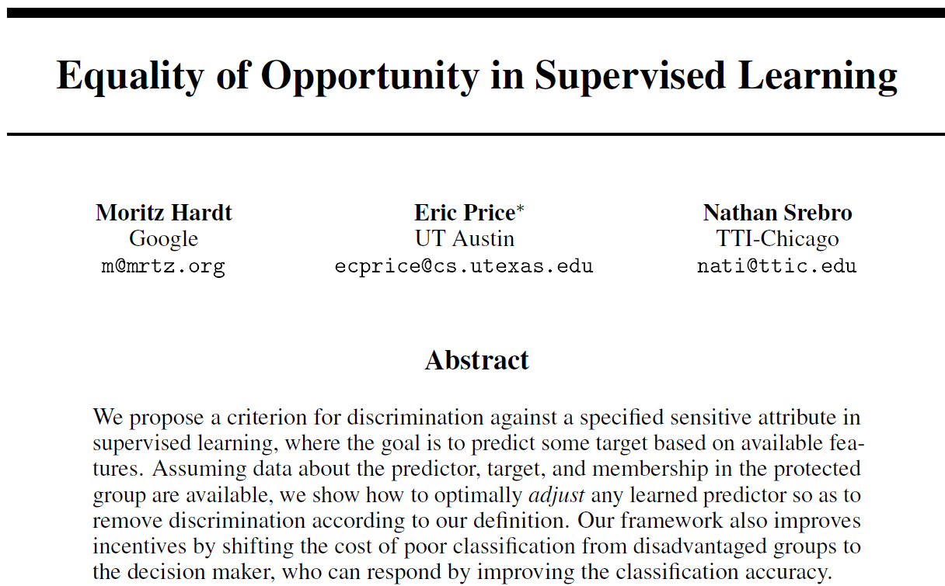
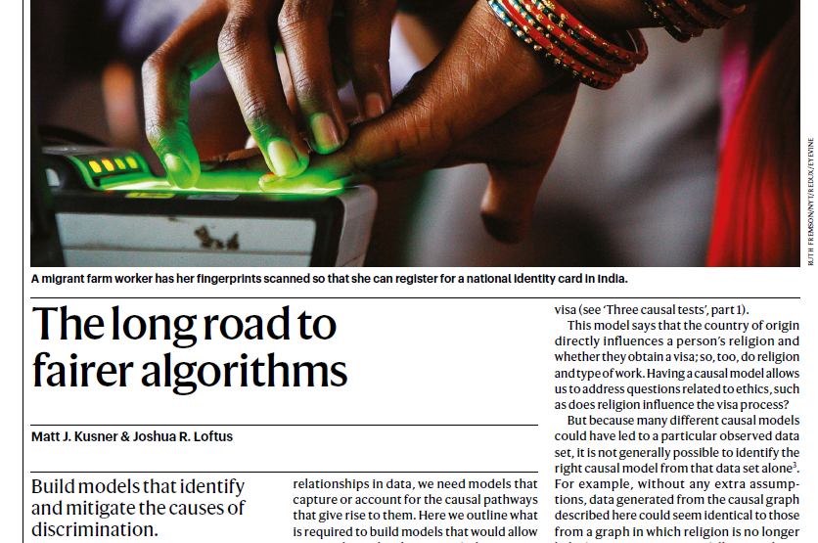
Fairness criteria [Hardt et al. 2016][Zafar et al 2015]
[Hardt et al. 2016]
Fairness through lack of awareness
demographic parity
equalized odds
equalized opportunity
Individual fairness
[Kusner & Loftus]
[Hardt et al. 2016] Hardt, M., Price, E., & Srebro, N. (2016). Equality of opportunity in supervised learning. Advances in neural information processing systems, 29, 3315-3323.
Notes:
[Teodorescu 2020] Fairness Criteria, Exploring Fairness in Machine Learning - https://www.youtube.com/watch?v=euwc0va-7Vo&list=PLUl4u3cNGP63IFQn8FklBOUhYVcmaxpOX&index=5
[Hardt et al. 2016] Hardt, Moritz, Eric Price, and Nati Srebro. "Equality of opportunity in supervised learning." Advances in neural information processing systems 29 (2016): 3315-3323.
Muhammad Bilal Zafar, Isabel Valera, Manuel Gomez Rodriguez, and Krishna P Gummadi.
Learning fair classifiers. CoRR, abs:1507.05259, 2015

Slide 16
Fairness through awareness
Definition [Grgic-Hlaca et al. 2016]: remove any data that are considered prima facie to be unfair.
Example – Take an algorithm used by judges making parole decisions, fairness through unawareness could dictate that data on ethnic origin should be removed when training this algorithm, whereas data on the number of previous offences can be used.
Caveats [Wilford & Khairalla 2019]:
data are usually and inevitably biased, e.g., number of previous offences can bear the stamp of historical racial bias in policing, as can the use of plea bargaining (pleading guilty being more likely to reduce a sentence than arguing innocence)
Impossible trade-off: either remove all data or keep biased data.
Grgic-Hlaca, N. et al. ‘The case for process fairness in learning: Feature selection for fair decision making.’ NeurIPS Symposium on Machine Learning and the Law (2016)
Wilford, M. M. & Khairalla, A. in Social Sciences Contributions to the Real Legal System Ch. 7, 132 (2019).

Slide 17
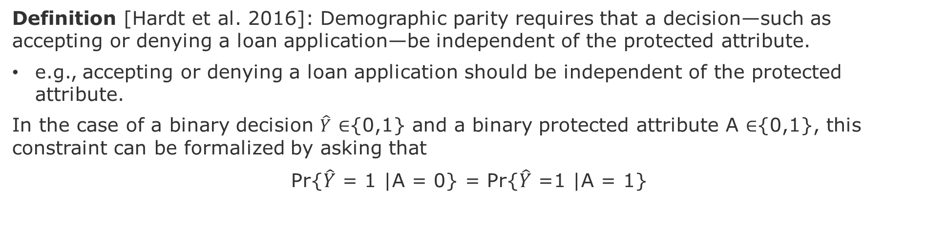
Demographic Parity
Definition [Hardt et al. 2016]: Demographic parity requires that a decision—such as accepting or denying a loan application—be independent of the protected attribute.
e.g., accepting or denying a loan application should be independent of the protected attribute.
In the case of a binary decision $\hat{Y}$ ∈{0,1} and a binary protected attribute A ∈{0,1}, this constraint can be formalized by asking that
Pr{$\hat{Y}$ = 1 |A = 0} = Pr{$\hat{Y}$ =1 |A = 1}
Caveats [Dwork et al. 2012]:
1- It doesn’t ensure fairness
2- It reduces utility of decisions that could be predicted with protected attribute
[Hardt et al. 2016] Hardt, M., Price, E., & Srebro, N. (2016). Equality of opportunity in supervised learning. Advances in neural information processing systems, 29, 3315-3323.
[Dwork et al. 2012] Dwork, C.,et al., (2012). Fairness through awareness. In Proceedings of the 3rd innovations in theoretical computer science conference (pp. 214-226).

Slide 18
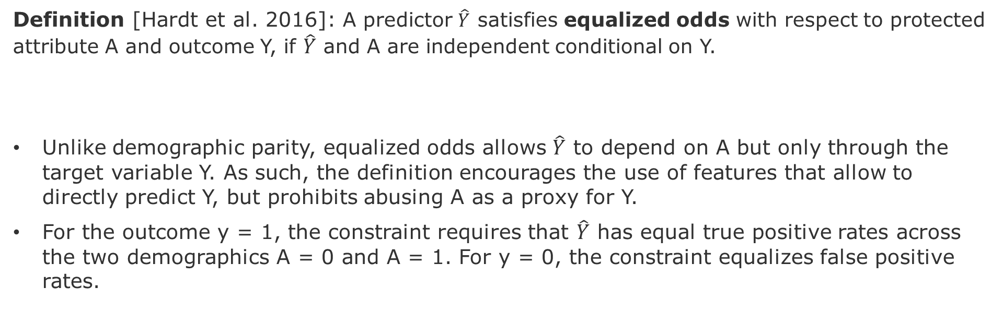
Equalized Odds
Definition [Hardt et al. 2016]: A predictor $\hat{Y}$ satisfies equalized odds with respect to protected attribute A and outcome Y, if $\hat{Y}$ and A are independent conditional on Y.
Unlike demographic parity, equalized odds allows $\hat{Y}$ to depend on A but only through the target variable Y. As such, the definition encourages the use of features that allow to directly predict Y, but prohibits abusing A as a proxy for Y.
For the outcome y = 1, the constraint requires that $\hat{Y}$ has equal true positive rates across the two demographics A = 0 and A = 1. For y = 0, the constraint equalizes false positive rates.
Caveat - equalized odds enforces that the accuracy is equally high in all demographics, punishing models that perform well only on the majority.
[Hardt et al. 2016] Hardt, M., Price, E., & Srebro, N. (2016). Equality of opportunity in supervised learning. Advances in neural information processing systems, 29, 3315-3323.

Slide 19

Equal Opportunity = giving the same beneficial predictions to individuals in each group
Definition [Hardt et al. 2016]: A binary predictor $\hat{Y}$ satisfies equal opportunity with respect to A and Y if
It allows for stronger utility as shown by experiments in [Hardt et al. 2016].
Caveats –
Equal opportunity is a weaker notion of non-discrimination
Typical societal unfairness is not captured by equality of opportunity.
[Hardt et al. 2016] Hardt, M., Price, E., & Srebro, N. (2016). Equality of opportunity in supervised learning. Advances in neural information processing systems, 29, 3315-3323.

Slide 20
Individual Fairness
Definition [Dwork et al. 2012]: similar individuals should get similar predictions.
Example - If two people are alike except for their sexual orientation, say, an algorithm that displays job advertisements should display the same jobs to both
Caveats [Dwork et al. 2012]:
Relies on a difficult concept of similarity
In this example, training data will probably have been distorted by the fact that one in five individuals from sexual or gender minorities report discrimination against them in hiring, promotions and pay [Pizer et al., 2011]
[Dwork et al. 2012] Dwork, C.,et al., (2012). Fairness through awareness. In Proceedings of the 3rd innovations in theoretical computer science conference (pp. 214-226).
Pizer, J. C. et al. Loy. LAL Rev. 45, 715 (2011).

Slide 21
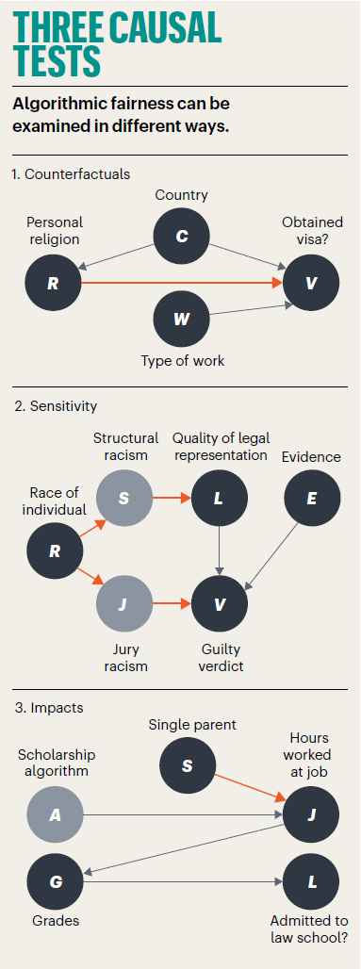
Recent discussion on criteria for fairness
Build models that identify and mitigate the causes of discrimination.
[Kusner & Loftus]
[Kusner & Loftus] Kusner, M. & Loftus, J., (2020), The long road to fairer algorithms, Nature.
Notes:
Matt J. Kusner & Joshua R. Loftus, 2020, The long road to fairer algorithms, Nature | Vol 578 | 6 February 2020, https://media.nature.com/original/magazine-assets/d41586-020-00274-3/d41586-020-00274-3.pdf

Slide 22
Overview of Design Space of Solutions

Slide 23
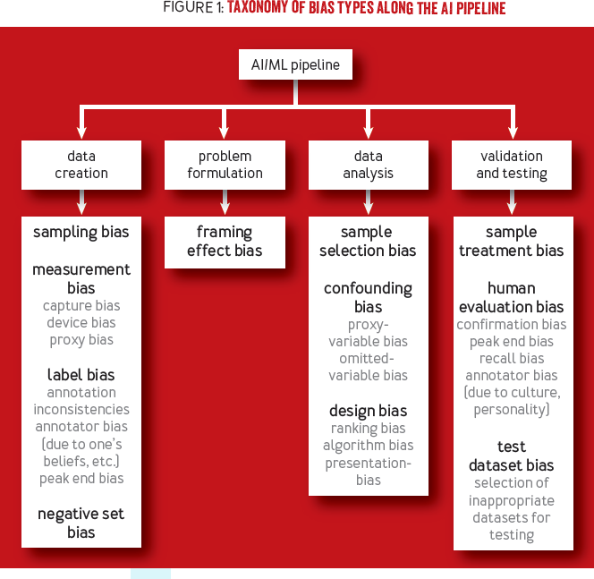
Taxonomy of Biases
There are many reasons for an engineer to have a wrong model of the world (figure-1)
These biases also impact users in very diverse ways.
I am more interested on bias sample selection bias and confounding bias (under the data analysis)
Before we delve into these bias, we need to answer the question, why many times simply getting more data does not solve the bias problem?
The Reason: the bias-variance trade-off
[Srinivasan & Chander 2021]
Notes:
[Srinivasan & Chander 2021]
]Biases in AI Systems
https://queue.acm.org/detail.cfm?id=3466134

Slide 24
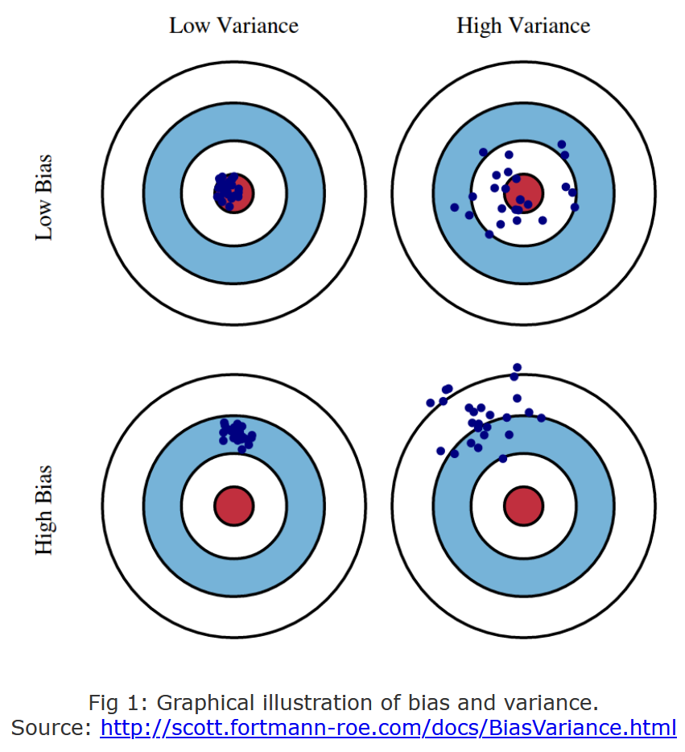
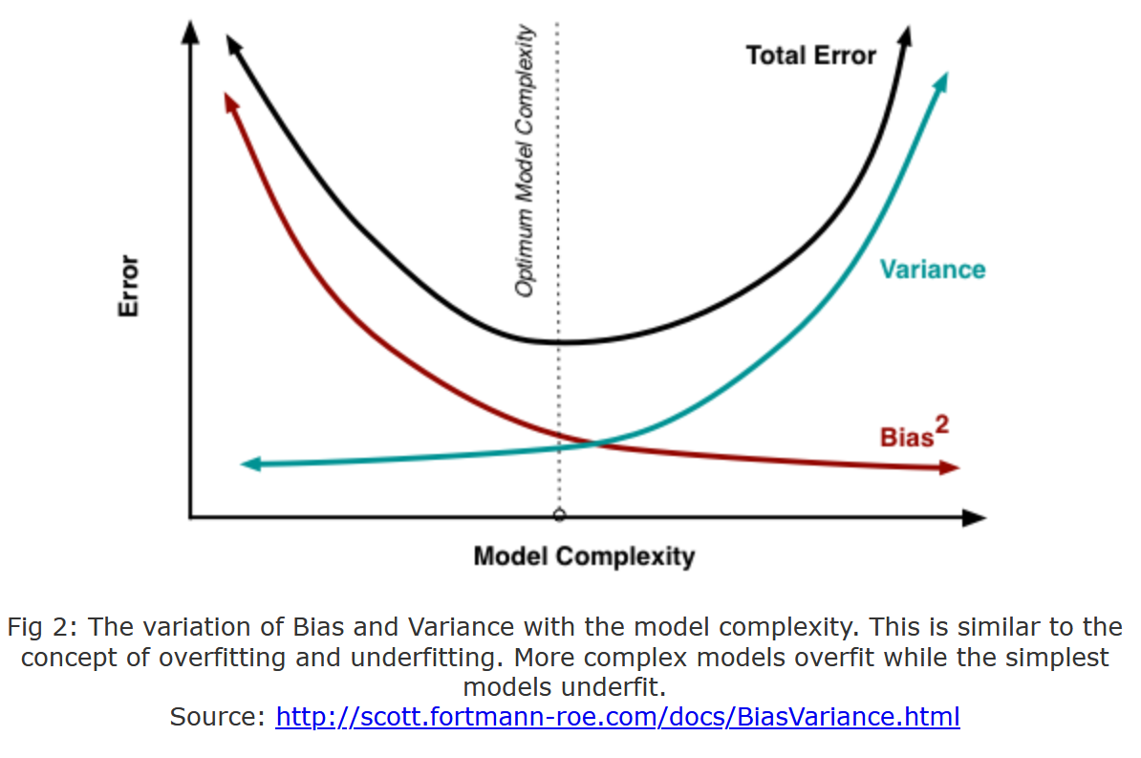
How do we currently think about robustness? -> Bias-Variance Trade-off

Slide 25
Implications to predictive models
Goal: Generalize data associations as predictive patterns
Assumptions: good data and observable patterns
Reality: sparse data and hidden states
Sparse data (Essential limitation, cannot eliminate with better prediction models)
Latent patterns (Accidental, can eliminate with better models)
Source – Misspecification
Not enough data or bad tunning of a model can make the concept drift more severe, as models might present strong bias (insensitive to crucial features) or high variance (too sensitive to noise).
Under-specification (leads to bias-underfitting)
Over-specification (leads to variance-overfitting)
Notes:
Model choice: wrong choice is accidental if not well-informed
Model generation: wrong if not well-informed
However, if after being informed with the best of our knowledge, choice and generation can still be affected by inherent difficulties posed by the essence of ml-based predictive models: Sparse data and Latent states. This means that better models can never eliminate the effects of sparsity and latency.
Nonetheless, it can still mitigate, reduce either their effects in terms of impact (magnitude) or their probability (over multiple training procedures).
Sparsity can be mitigated with models that allow to incorporate and update prior-knowledge, e.g., Bayesian methods, transfer learning methods.

Slide 26
Adversarial Changes in the Environment Sources of Sparsity and Unobservability
Changes in the Data Generation Process:
Covariate Shift (change in data distribution)
Domain Shift (change in the action-state space)
Concept Drift (change in the associations)
These changes are independent of the model, but the model might make the problem worse.
Goal: A robust model should have structures and conditions in place to mitigate the effect of these changes on the performance of the model.
Plausible Changes -> Sparsity + Observability -> Model performance

Slide 27
Mitigation of Ethical Failures / Dilemmas Data-Centric vs Systems-Centric
Data-Centric: Which data problems (data privacy violations, biases, etc.) are ethical dilemmas or failures in machine learning models? Mitigation might involve, pre-process data, obtain better data, augment data, or use more robust statistical methods (e.g., less prone to overfitting).
Systems-Centric: Which levels of autonomy contribute to ameliorate or degrade the ability of a system to handle ethical dilemmas?
Design Aspects - feedback loops, cross-cutting concerns (monitoring, exception handling, failure propagation), decision-making mechanisms (agents, controllers), and the corresponding actuators.
General Goal - How AI-Systems can self-adapt to cope with adversarial changes in the environment that impose ethical failures / dilemmas
Example: to redesign an avionics system to comply to a more appropriate set of ethical requirements one needs to go beyond better prediction models. One needs to understand which aspects of the system contribute to ethical failures and how these can be mitigated. Noting that mitigation actions might involve new ethical choices.

Slide 28
Adversarial Fragilities Online (Continual) Learning
Hidden confounders + Selection Bias
Simpson’s and Berkson’s paradoxes
Shortcut learning in Neural Nets
This goes beyond overfitting, as it cannot be solved with more or better data!
Underspecified Models
Unsafe state-action Spaces
Non-IID and OOD Data
Wrong predictions can spur unsafe actions that can lead to unsafe states.
Sensitivity analysis and testing on hold-out-sets are ad hoc approaches cannot guarantee safety.
“Program testing can be used to show the presence of bugs, but never to show their absence!” ― Edsger W. Dijkstra
Real-world is non-stationary
Predictions affects the data generation process
Modeling better recommender systems is not enough, because uncertainty grows wildly when extrapolating out-of-distribution
Notes:
“Program testing can be used to show the presence of bugs, but never to show their absence!” ― Edsger W. Dijkstra

Slide 29
Adversarial Fragilities - Solutions Online (Continual) Learning
Pre-trained models:
Optimal Bias-Trade-off for fine-tuning
Rashamon sets
Domain-Adaptation
Invariant Representations
Underspecified Models
Unsafe state-action spaces
Non-IID and OOD Data
Generative models of OOD
Sampling-based (importance sampling)
Feature-based (new task)
Intervention-based (control)
Safe learning in production:
Specify safety (domain-knowledge, Constrained MDP, Shielding)
Learn to be safe (sandbox/digital-twin)
Notes:
Operational envelope (engineering idea) for safe/robust learning (% of safety violation guarantee)
Business critical systems
Critical State Spaces
Envelope has to be evolved as well
How to know that the envelope is valid.
Lecture on Safety&Resilient Systems – structures that adjust (reviewing safety margins)
Accidents trigger reviews of safety margins
Human-on-the-loop (confirm the automated decision)
Recommendation system – how many are accepted vs rejected
Imitation learning vs Reward modeling
Crash example (how many people were affected), not possible, because measurements are also missing in a crash (income loss, satisfaction loss), e.g. Counterfactuals. These are phenomena that the runtime model can estimate indirectly (failed transactions)

Slide 30
Connections between Fairness and Robustness
Zhang, B. H., Lemoine, B., & Mitchell, M. (2018). Mitigating unwanted biases with adversarial learning. In Proceedings of the 2018 AAAI/ACM Conference on AI, Ethics, and Society (pp. 335-340).
Kilbertus, N., Rojas-Carulla, M., Parascandolo, G., Hardt, M., Janzing, D., & Schölkopf, B. (2017). Avoiding discrimination through causal reasoning. arXiv preprint arXiv:1706.02744.
Suggested questions
How do failures in satisfying fairness requirements lead to lack of robustness?
What type of robustness engineering methods can be used to reify fairness requirements?
How fairness can be achieved by means of Learning to be Safe, Fail-Safe Resilient, Recoverable mechanisms?
?

Slide 31
Wicked Problems Rittel, H. W. J., & Webber, M. M. (1973). Dilemmas in a general theory of planning. Policy Sciences, 4, 155-169. See page 160.

Slide 32
Wicked Problem [Rittel & Webber 1973] page 160
1. There is no definitive formulation of a wicked problem: \\ very unstructured like ill-posed questions, misspecified queries, exploratory inquiries 2. Wicked problems have no “stopping rule”
\\ i.e., definitive solution, global optima, etc.
3. Solutions to wicked problems are not "true or false", but either good or bad.
\\ a bit cryptic, but I would draw an analogy with the asymmetry between confirmation and disconfirmation of certain empirical claims - one can easily disprove an empirical claim (e.g., all swans are white), but one can not prove it in definite (only increase one's confidence after each successful disconfirmation attempt).
4. There is no immediate and no ultimate test of a solution to a wicked problem
\\ so, essentially worse than NP-complete problems...

Slide 33
Wicked Problem [Rittel & Webber 1973] page 160
5. Every tentative solution to a wicked problem is a “one-shot operation”, because there is no opportunity to learn by trial and error \\ i.e., like the 2nd law of thermodynamics, irreversible process, or in math, non-invertible transformations like surjective mappings, or other types of asymmetry in topology, geometry that collapse dimensions.
6. Wicked problems do not have an enumerable or an exhaustively describable set of potential solutions, nor is there a well-described set of permissible operations that may be incorporated into the plan. \\ consequence of 3 and 4.
7. Every wicked problem is essentially unique \\ consequence of 1 and 2.
8. Every wicked problem can be considered a symptom of another problem \\ so, all is not lost, we just need to decompose it into subproblems...

Slide 34
Wicked Problem [Rittel & Webber 1973] page 160
9. The existence of a discrepancy representing a wicked problem can be explained in numerous ways. The choice of explanation determines the nature of the problem's resolution
\\ Consequence of 4. Multiple explanations means implies an impossibility to falsify our models purely on experience/data, but we still can have attribute more confidence on certain explanations than others.
10. The planner has no “right to be wrong”
\\ Although most scientists are indulged w.r.t. to their mistakes, this is not true for all researchers. Take research in engineering and medical sciences, where failures frequently cause irreparable harm.

Slide 35
Warm-up task: Start thinking about ethical dilemmas and concrete cases
Choose a domain and an ethical dilemma that looks like a wicked problem
Research two definitions for the same ethical principle
Research one fail case with a corresponding discussion (data and system-centric)
Describe briefly (~4 lines) and write down your opinion (~4 lines)
Share it on Slack by Friday Evening (channel #writting)

